Slide 1


Increasing trust in human-robot medical interactions: effects of transparency and adaptability
Human Robot Interaction Lorenzi Flavio
1662963
Ciciolla Michele Lorenzi Flavio
Medical Robotics

Slide 2
References
Increasing trust in human–robot medical interactions: effects of transparency and adaptability
https://www.researchgate.net/publication/326165321_Increasing_trust_in_human-robot_medical_interactions_Effects_of_transparency_and_adaptability
Towards Robotic Systems for danger recognition and alert
https://youtu.be/GgLX67rOrDM?t=66
Increasing trust in human-robot medical interaction

Slide 3

The problem
In a healtcare scenario with service robots the trust in the system is very important
Main roles in this particular situation are:
System performance
Failure rate
Technical competence
Situation management
We shall trust the medical stuff and the robot is part of this stuff
Is this enough?
Solution: introducing and increasing the transparency and adaptability of the robot can bring the patient to be less scared and to create a bond with it
Increasing trust in human-robot medical interaction

Slide 4
Previous works
What is transparency?
The human should be able to understand the reason for unexpected behavior of the robot,
knowing in advance the statistics of its performance or failure rates
The robot must always announce its moves and ensure maximum clarity of intent,
ensuring awareness of what it is doing, keeping maximum competence
What is adaptabilty?
The robot is able to adapt itself to the particular condition in which it is
Interaction with the human to ”adjust something wrong” to seem less intrusive
It could change personality, speed, position or any other similar feature to increase the human comfort as much as possible
Increasing trust in human-robot medical interaction

Slide 5
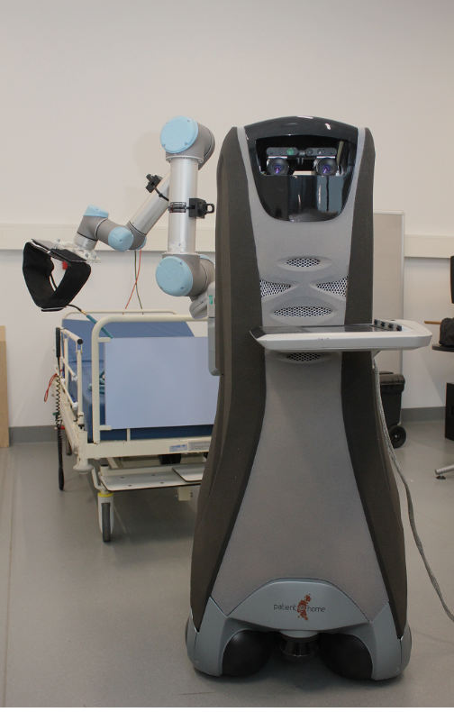
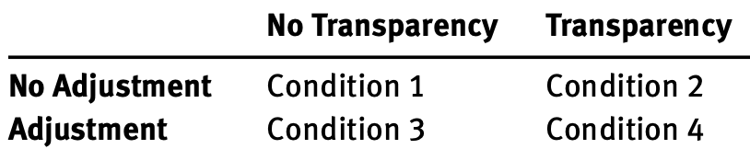
Methodology -1
Task: blood pressure measurement
Partecipants: 85 students and staff from a danis University with average age of 30
Environment: university laboratory room, well set up for the event
Aim: perform the task putting patients at their ease
Four different conditions are tested in the experiment:
CARE-O-BOT 3 with 6 dof arm
Increasing trust in human-robot medical interaction

Slide 6
Methodology -2
People are randomly divided in these different conditions to then study the results
CONDITION 1
CONDITION 2
Basic case,
with no implementations
Transparency condition
“I'm going to move my arm”
“Tell me when you are ready”
CONDITION 3
CONDITION 4
Adaptability condition
Slowing movements when close to human
Allowed to adjust the position of the bracelet
Hybrid version, with both
the implementations:
Transparency comments
with allowed adjustments
Increasing trust in human-robot medical interaction

Slide 7

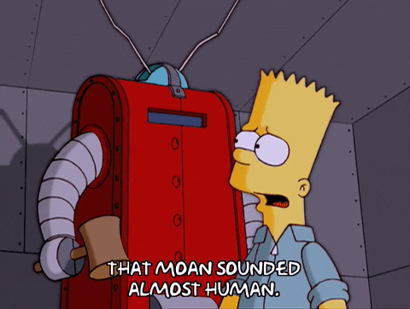
Study case
The experiment comprises 3 parts:
Pre-experimental questionnaire
General informations are provided
The experiment proper
Four phasis for human robot interaction:
Enter, Preparation, Misuration, Exit
according to the current condition;
Video recorded for a careful post analysis
A post-experimental questionnaire
How did it go with the robot?
Closed-ended questions about the feelings
experienced on a range scale between 1 and 7
Increasing trust in human-robot medical interaction

Slide 8
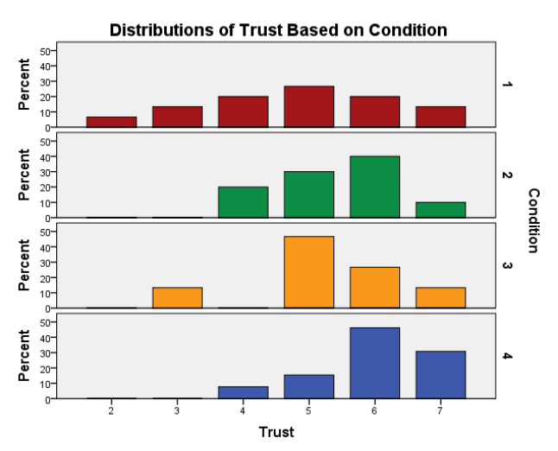
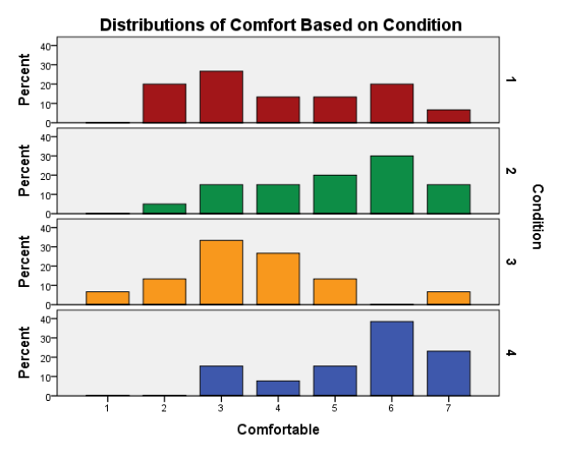
Results
Some technical problem during the experiment has influenced the final results
Between all the sensations experienced, the greatest benefits came from the
trust in the robot and the comfort, in particular in conditions 2 and 4
The transparency is the best way to improve the trust, better than adaptability
Increasing trust in human-robot medical interaction

Slide 9


Focus on HRI
The experiment was video-recorded for a post experiment “qualitative analysis”, that showed that:
Not all subjects were comfortable during the interaction (initially shy or unable to speak)
The robot should have interacted more: only a few comments during the entire experiment is not enough
A few more comforting comment would have helped:
“it’s going to be ok” … “Only 10 seconds left”
“We're almost done” … “Well done!”
Increasing trust in human-robot medical interaction

Slide 10
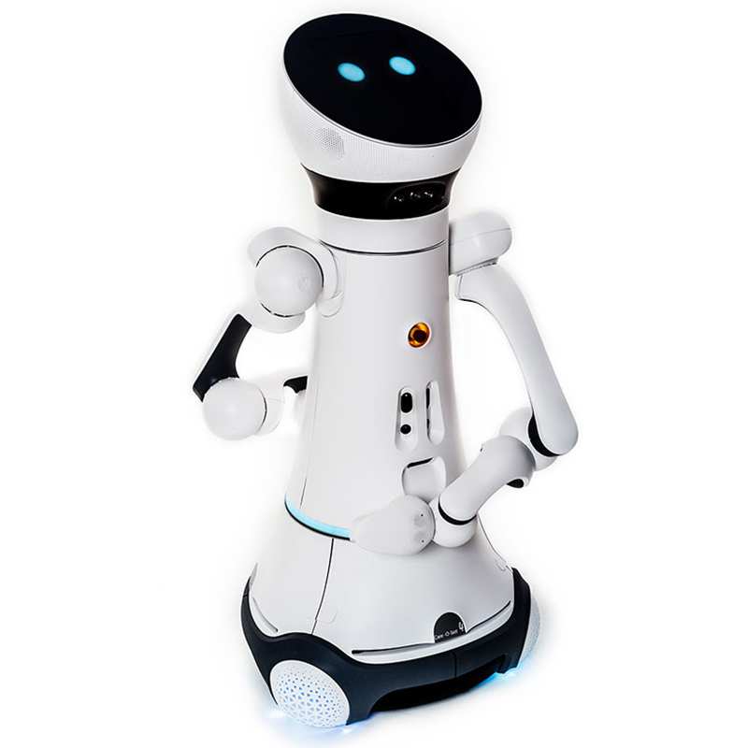
Conclusions and future works…
Transparency has positively influenced perceived comfort and trust
Unfortunately, this was not enough for some participants and should be improved
In the future it would be useful to implement:
Wider range during the spoken interaction
Better adaptability mechanism, with deep learning on board
Improving the trust in other ways:
More cute physical characteristics (i.e. the new version of the CARE-O-BOT or like the Pepper robot)
Warm and soft voice
Ability to reproduce human movements, and so on…
CARE-O-BOT 4
Increasing trust in human-robot medical interaction

Slide 11
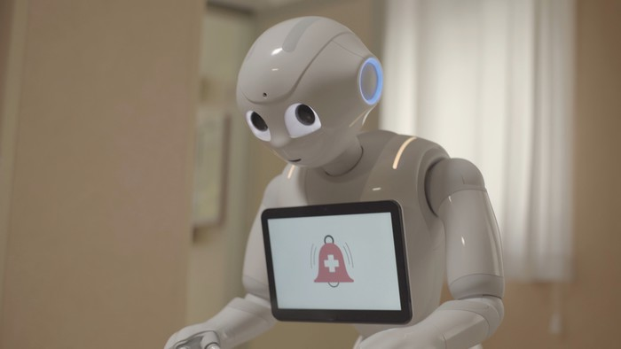
…today in Italy
In Italy we have also a recent experiment with the
introduction of the Pepper robot into the Casa di Sollievo
in Foggia, developed by Konica Minolta company
https://youtu.be/GgLX67rOrDM?t=66
Increasing trust in human-robot medical interaction

Slide 12
Ideas for the project
Main idea: help humans in healtcare environment with service robots
Robots are always active and alert.
Robots cannot get sick: no risk of contagion.
Robots are an important external help: cooperate but no replace
From the original paper: transparency concept during the interacion and a questionaire to evaluate its performance with a final feedback.
Additional tasks: info point and human facial/gesture detection:
“Need some help?”, “The room 123 is on the third floor”, and so on…
Increasing trust in human-robot medical interaction

Slide 13
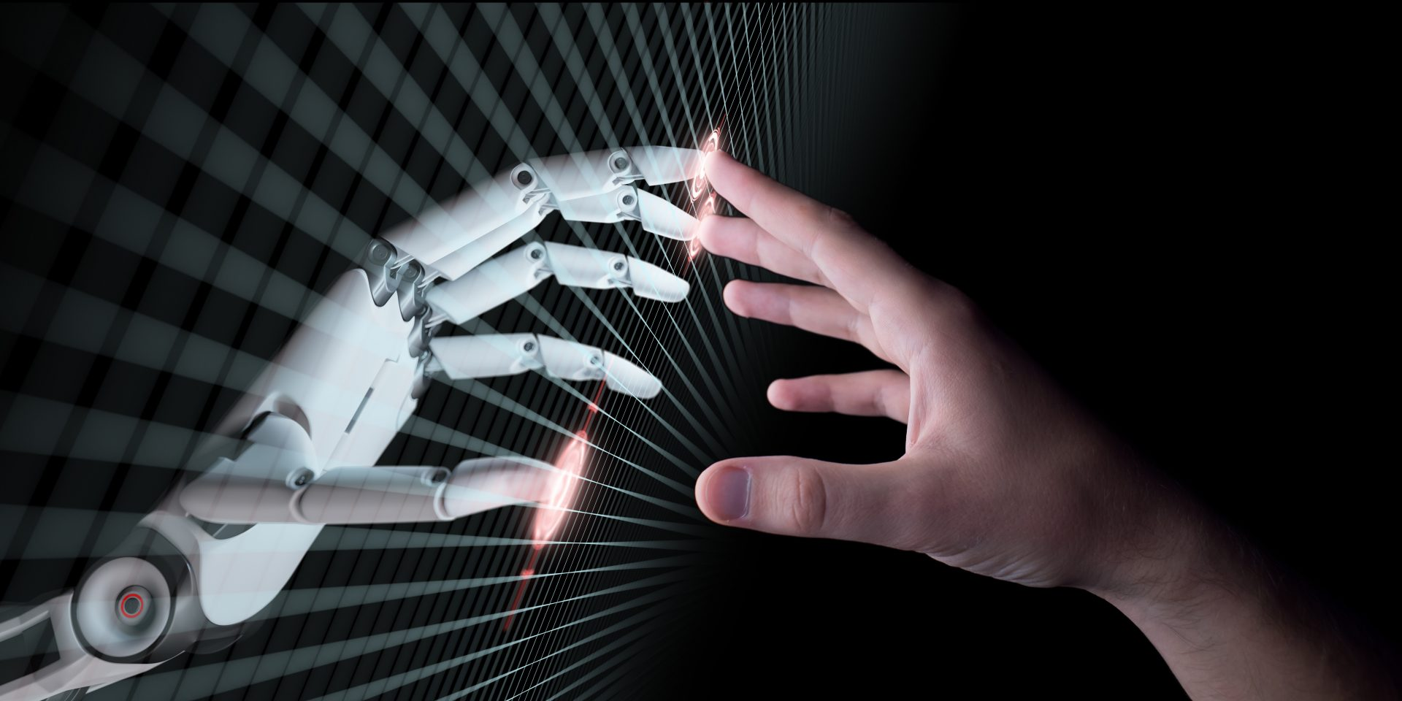
Thanks for your attention
Lorenzi Flavio – Human Robot Interaction

